Slide 1

IS Gen Z From Another Planet?
The Reality of the World Young People Live in and How you can Relate

Slide 2

Agenda
Trends that formed Gen Z
Identifying features
Best Practices in working with them
How change is impacting us all
The role you can play

Slide 3
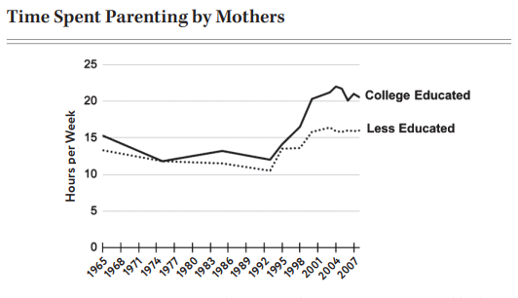
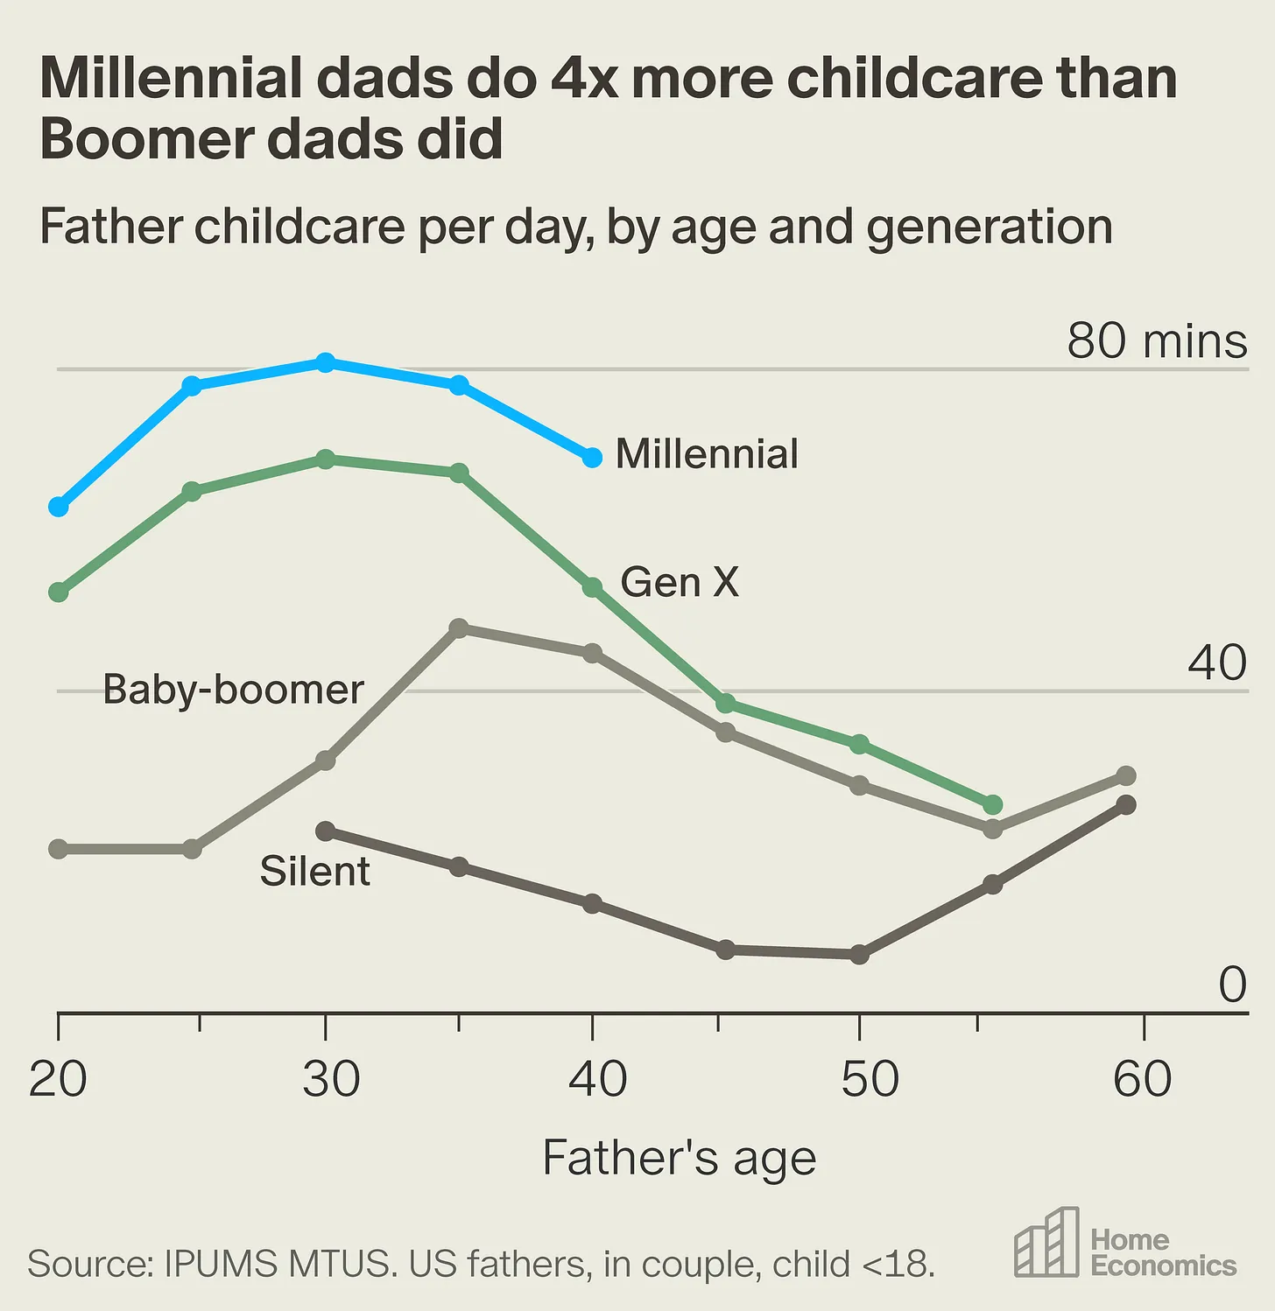

Protective Parenting Meets the age of the Smart Phone

Slide 4
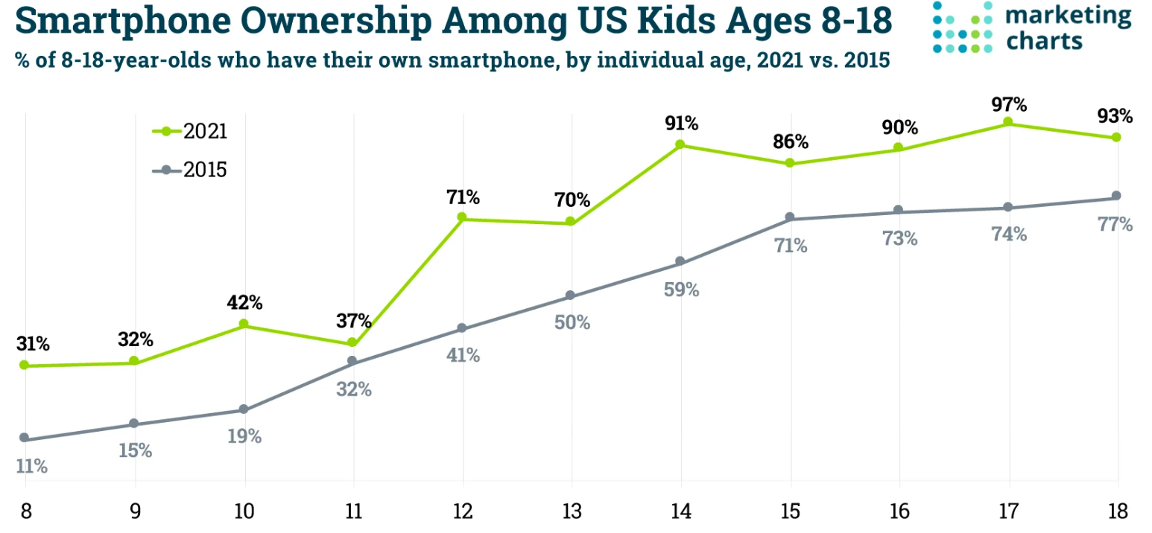

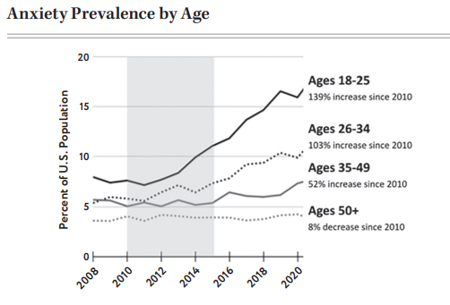

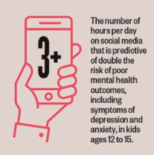
Protective Parenting Meets the age of the Smart Phone

Slide 5
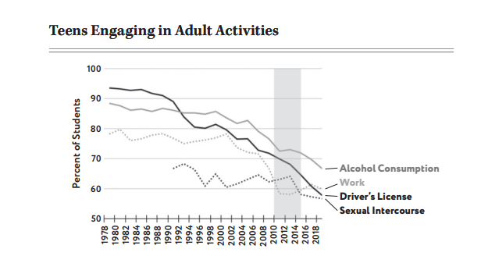

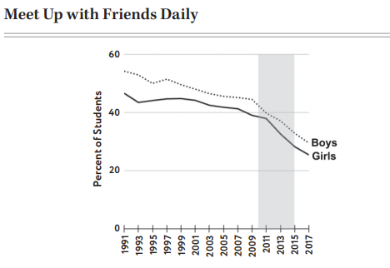
Protective Parenting Meets the age of the Smart Phone

Slide 6
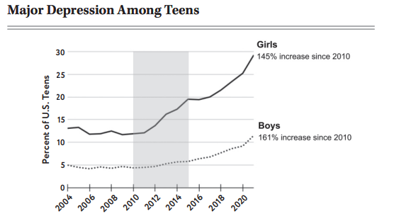

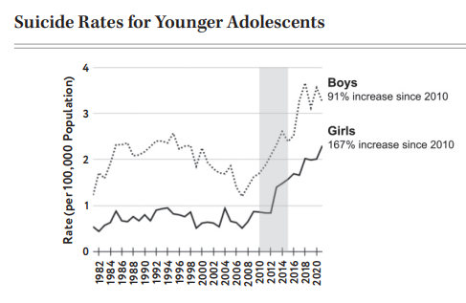
Unintended Consequences

Slide 7
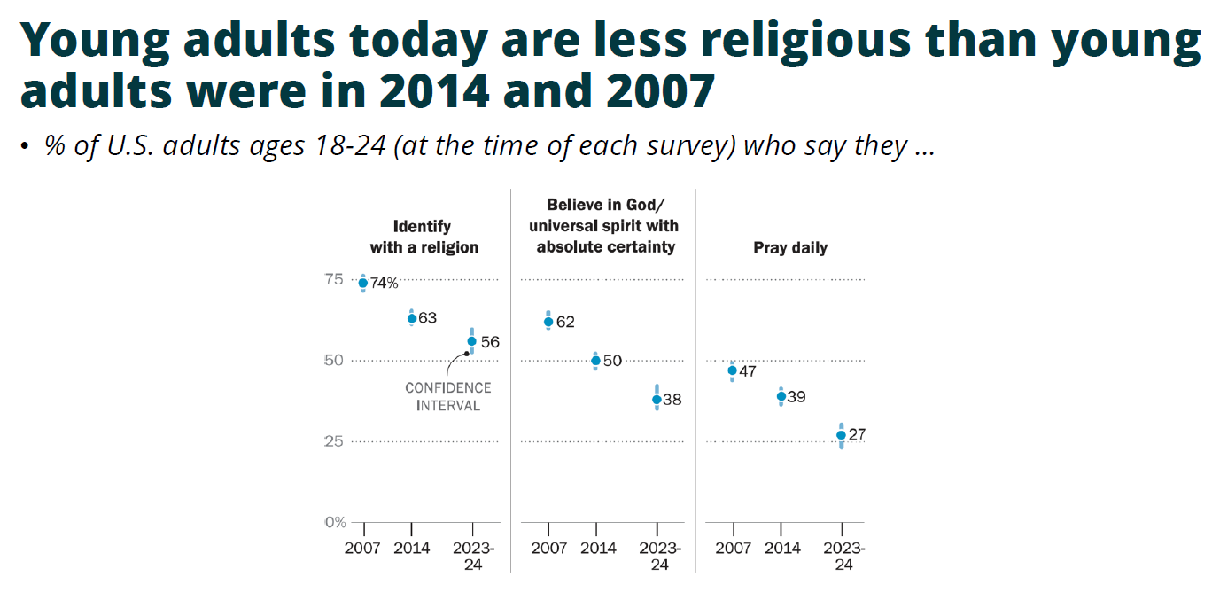

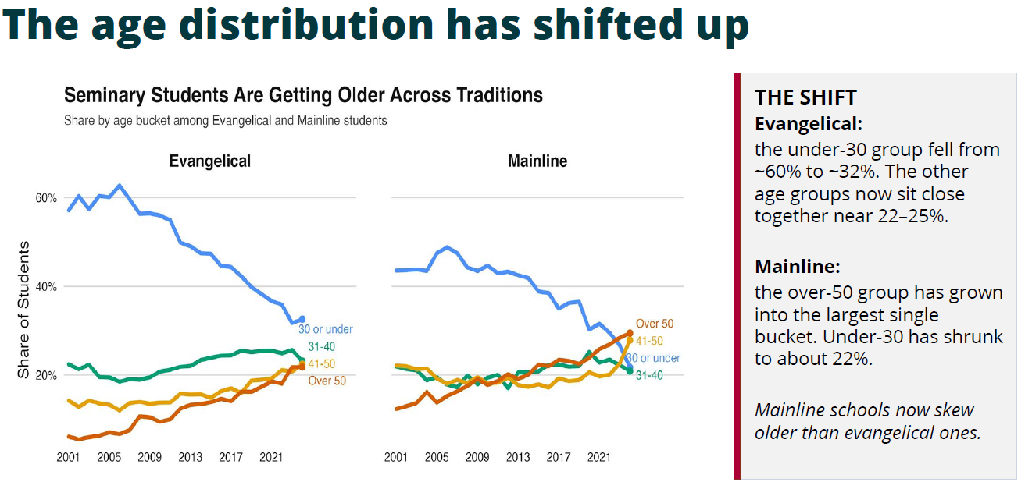
Religious Implications

Slide 8

Salvation Conversations
Past:
You are a sinner
You need someone to pay the price for you
Jesus is the Savior
He can save you from your sins
Gen Z:
The world is broken
You have contributed to that brokenness
Jesus is the Prince of Peace
Jesus can restore all things

Slide 9


Identifying Features of Gen Z
Tech Savy
Risk Averse
Financial Pragmatists
Shorter Attention Spans
Open and Accepting
High Diversity
Non-Judgmental
Anxious
Asynchronous and ageless social interractions
Adaptive
Teachable
Values Authenticity
Values self care
Difficulty Accepting Negative Feedback

Slide 10



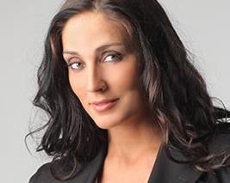
Working with Gen Z
Impact of the Digital Age
Broad Perspective
Niche Interests
Anticipate shorter attention spans, a pragmatic and impatient approach to information flow, and a bias toward visual learning
Not locked into the 2-party system, views are more extreme, less unifying narratives and experiences
Share is the New Care
Limited Experience
Encouraged to express feelings regardless of context, not aware that this was not done in the past or how to manage it
Young adults now have more digital experience, but less experience in other areas of life. Be open to more asking and teaching to fill gaps.

Slide 11


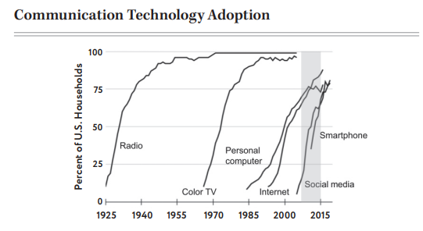


Change is Impacting Us All
By 2030, artificial intelligence could displace around 85 million jobs to 300 million full-time jobs globally
Young people are impacted the most by these changes
There are less universally accepted norms and expectations to measure oneself by than in the past
Young people get a new set of bosses constantly
Most things in a young person’s life are temporary; they have very little to build or lean on

Slide 12




The Role You Can Play
Own The Change
Be a Pillar in the Storm
Those under 30 control 1%-2% of the US economy
Less than 1% of CEOs are members of Gen Z
Gen Z has to question everything, things we never did, be the unmoving force in their life, represent a gospel, truth, and love that never changes
Listen and Care
Offer a Toolbar
When polled, Gen Z fears judgement and rejection from older adults but longs for listening and relationship
Past generations had instruction manuals, things change too fast now, show them the methods and rationale and let them experiment and fail forward
Don’t take back the keys

